Slide 1
FROM EXAMINATIONS TO SCHOOL BASED ASSESSMENT...
28th APRIL, 2014
DR. SADHANA PARASHAR
DIRECTOR (ACADEMIC, RESEARCH, TRAINING & INNOVATION), CBSE

Slide 2
Teacher directed / Classroom Centric
Learner centred/ Community oriented
Instructor
Other Schools
And Organizations
Class
Library
Experts
Learning
Communities
Internet
Portal

Slide 3
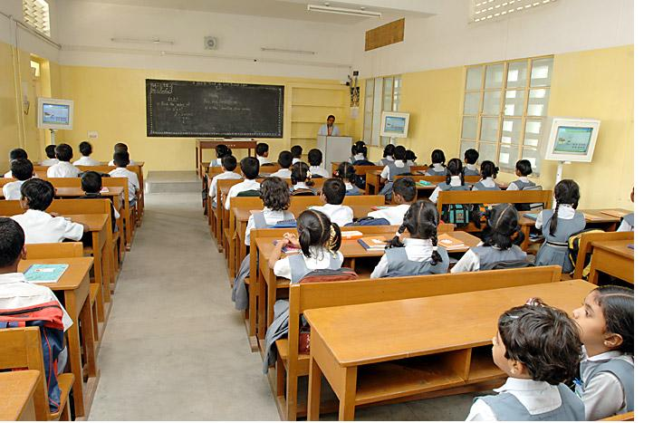
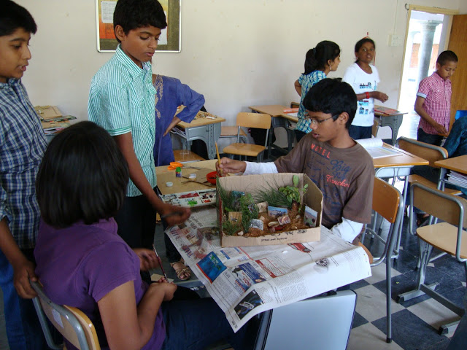
Individual Focus
Collaborative work
Theory
Practice
Knowledge
Skills

Slide 4
A GLIMPSE OF THE RESULTS SO FAR...

Slide 5
ANALYSIS OF RESULTS
RESULTS OF THE FIRST BATCH OF CLASS XII WHO FACED CCE IN CLASS X FOR THE FIRST TIME
The Pass % for Class XII has increased from 80.99% in 2009 to 82.10% in 2013 (highest in past 5 years)
The trend can be seen across all the 4 categories of schools – Pvt. Independent, Government, Kendriya Vidyalayas and Navodaya Vidyalayas

Slide 6
ANALYSIS OF RESULTS
Year | 80%-85% | 85%-90% | 90%-95% | 95%-100% | >80%
2009 | 6.6% | 4.8% | 2.4% | 0.1% | 13.9%
2010 | 6.0% | 4.4% | 2.2% | 0.1% | 12.8%
2011 | 6.3% | 4.8% | 2.8% | 0.2% | 14.1%
2012 | 6.6% | 5.3% | 3.6% | 0.5% | 16.1%
2013 | 6.7% | 5.6% | 4.3% | 0.7% | 17.3%
The percentage of students scoring more than 80% in Class XII Board Exams has increased from 13.9% in 2009 to 17.3% in 2013.

Slide 7
ANALYSIS OF RESULTS
Comparison of performance of students in class-XII Board exams (2013) – categorized on their taking Board exams or School Based Assessment in class-X (2011):
The marks in the main subjects’ viz. Accountancy, Economics, Biology, Chemistry, Mathematics, Physics, English (Core), Hindi (Elective) and Hindi (Core) were compared and analysed.
For students who took SBA, mean marks was higher with a greater consistency in their performance (Lower Standard Deviation) in all the subjects except, English (Core).

Slide 8
ANALYSIS OF RESULTS
 | STUDENTS WHO TOOK SCHOOL BASED ASSESSMENT IN CLASS-X (2011) |  | STUDENTS WHO TOOK BOARD EXAM IN CLASS-X (2011)
 | MEAN MARKS | STD. DEVIATION | MEAN MARKS | STD. DEVIATION
Accountancy | 61.8 | 20.2 | 58.6 | 20.6
Economics | 52.1 | 25.2 | 46.4 | 25.8
Biology | 71.9 | 16.9 | 69.2 | 17.2
Chemistry | 69.7 | 17.7 | 66.5 | 17.8
Mathematics | 55.1 | 26.2 | 49.8 | 27.1
Physics | 64.1 | 17.2 | 60.8 | 17.2
English Core | 64.8 | 21.7 | 65.7 | 20.2
Hindi Core | 69.5 | 16.1 | 66.7 | 16.4
Hindi Elective | 57.4 | 15.5 | 55.4 | 16.5

Slide 9
ANALYSIS OF RESULTS

Slide 10
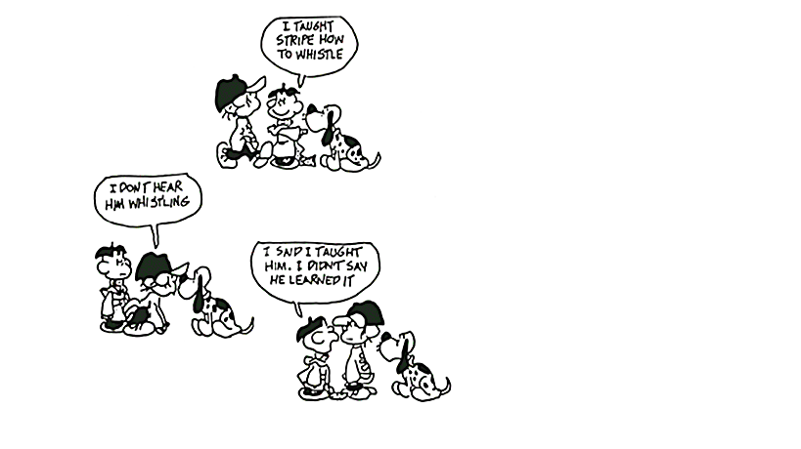
CHALLENGES OF ‘SCHOOL BASED ASSESSMENT’
Source: ‘Leaders Resource – Getting Started’ produced by Teaching and Learning Services DECD
Notes:
Just because we teach something does not mean students have learnt it!

Slide 11
CHALLENGES OF ‘SCHOOL BASED ASSESSMENT’
Formative Assessments need to be integrated into teaching learning process
This understanding is still missing!
FA’s should be diagnostic and remedial
Focus should be on ‘Learning’ and NOT on ‘Recording & Documentation’
Transforming memory-based fragile learning into thinking-based sustainable learning!

Slide 12
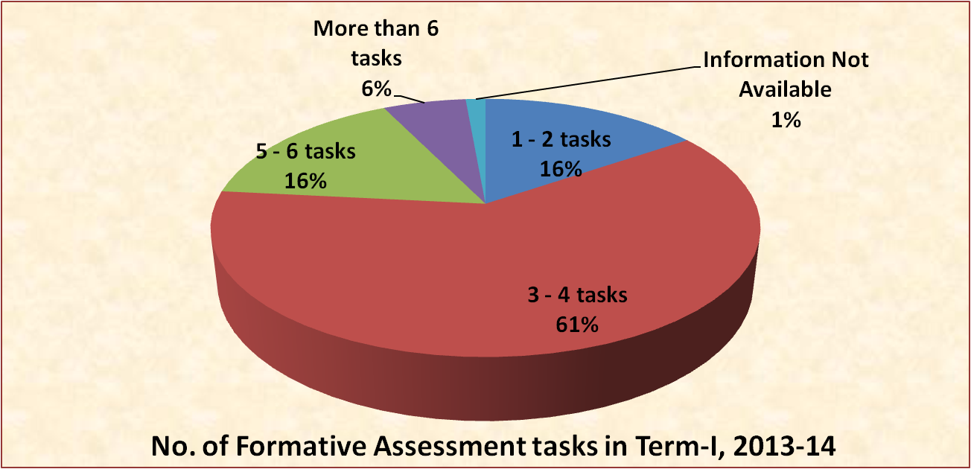
CHALLENGES OF ‘SCHOOL BASED ASSESSMENT’
In the name of FA’s, there are ‘too frequent’ and ‘too many’ assessments.

Slide 13
CHALLENGES OF ‘SCHOOL BASED ASSESSMENT’
Diversity in ‘types of schools’:
Private independent schools
Kendriya Vidyalayas
Jawahar Navodaya Vidyalayas
Govt./Govt. aided schools
Tibetan schools
Diversity in ‘kinds of teachers’ – From ‘Self motivated’ to ‘highly motivated’ to ‘complacent & lazy’
Strong need for massive teacher orientation

Slide 14
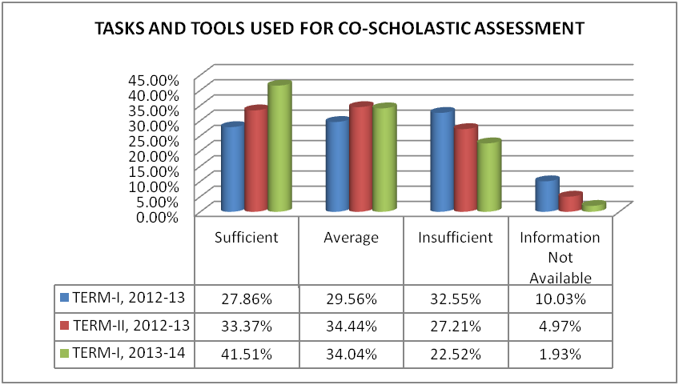
CHALLENGES OF ‘SCHOOL BASED ASSESSMENT’
Assessment of Co-Scholastic Areas is still a problem for many.

Slide 15
WorldKids Co-Scholastic Assessment Pilot
Lessons in Life: A year long curriculum for the schools opting for Co-Scholastic Assessment.
Two short films specifically selected for their power to illustrate Life Skills, Values and Attitudes
Instructions for Teachers as to how to introduce the film and make the most of the experience for their students, and
A multiple choice questionnaire designed to measure the extent to which students have imbibed the lessons (to be administered in class by the Teacher).
2nd February – 25th April 2014
37 Schools, 110 Teachers, 20 Cities, 4501 Students
Online Module 34%
Offline Module 66%

Slide 16
WorldKids CO-SCHOLASTIC ASSESSMENT MODULE - PROCESS
The module generates statistically significant assessments of a student’s strengths in Life Skills by gauging their understanding of and reaction to the ethos and events captured in a short film.
The answers to a multiple-choice questionnaire, through forced choice generate individual probabilities of inclined behaviour, which are then co-related with appropriate and affirmative descriptive indicators.
Scientific marking approach, reduces the risk of biased remarks
Since no response is assessed as incorrect, the intrinsic nature of the student is highlighted
It is an age appropriate, experience learning exercise and not traditional cumbersome pen & paper test for the students

Slide 17
PRINCIPALS’ RESPONSES
“The unique design of the assessment helps to discover the distinctive strengths and attributes of each individual student, thus being an effective source of evaluation.”
Manju Rana Seth Anandram Jaipuria School, Ghaziabad
“This will be a godsend for teachers who don’t study students as individuals and allot random grades which are often biased or subjective.”
Poonam Kochitty
Sri Ramswaroop Memorial School, Lucknow
“The exercise was found to be user-friendly and we got the results in a very short time. Even the visually challenged students were able to attempt the test with the audio which had been prepared on the request of the school.”
Dr. Indu Khetarpal
Salwan Public School, Rajinder Nagar, Delhi
“Though it was a short film the impact was long lasting and the questionnaire apt as it touched every aspect of life. It was particularly beneficial for teenage students as they learnt values and were able to have a better insight about their personality as well as of their peer group.”
Rajiv Kumar Sharma Springdale Senior School, Amritsar

Slide 18
PRINCIPALS’ RESPONSES
“The methodology used to diagnose and draw out realistic responses from the students was scientific, unambiguous and unbiased.”
Anjali Razdan
Epistemo Global School, Hyderabad
“I would strongly recommend such convenient and relevant activity for the formative and summative assessment on regular basis.”
Savita Arora Bharti Public School, Delhi
“It brought an objective form of evaluation and relieved teachers of the tedious data collection process.”
Nirmala Krishnan
Mahindra World School, Chennai
“Students & teachers will greatly benefit from this module as this is an overall assessment of the child’s personality which will go a long way in enhancing skills.”
Rita Chatterjee Apeejay School, Kolkata
“The feedback has very subtly given teachers a clear view of skills & attitudes of students and will surely go a long way in motivating them.”
Sunita Babu
Cambridge International School, Amritsar

Slide 19
PRINCIPALS’ RESPONSES
“The concept behind peer assessment was very much appreciated as it gave a 360 degree approach where not only the child but peers have assessed him/her on the same indicator.”
Melvin Pereira The Kings School, Goa
“The tool enabled the students to relate to personal experience, self introspection, peer evaluation & understanding the gap while indicating the areas of improvement.”
Dr. S. Bhavanishankar
Lalaji Omega International School, Chennai
“The purpose of the assessment is to help the students to know themselves & to adopt right approaches and skills. It is one of the best methods to assess Life Skills.”
Rashmi Vij
Police DAV School, Jalandhar
“The entire activity is a unique experience & supports interaction among students & teachers providing each child with the opportunity for self assessment & for the teachers to be a non-judgmental friend, philosopher and mentor.”
Meenu Goswami Bal Bharti Public School, Delhi

Slide 20
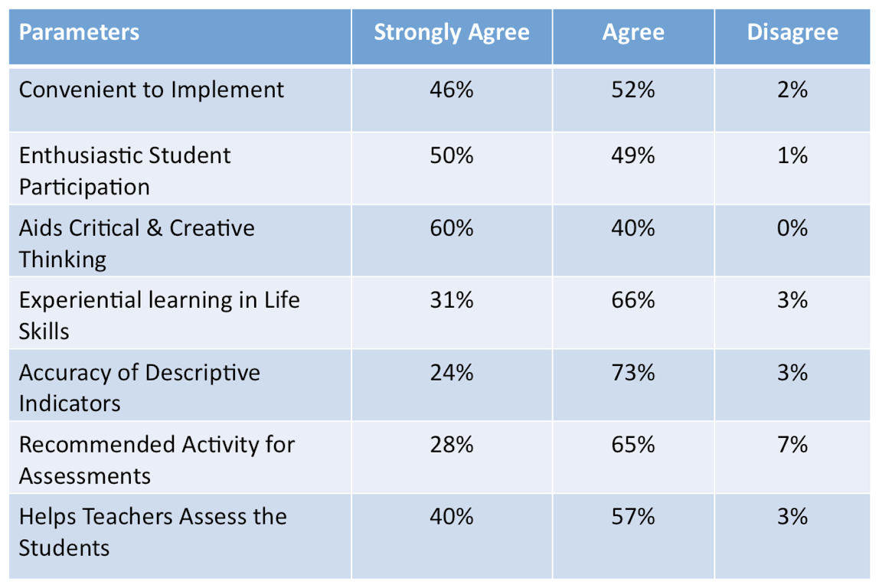
TEACHER’S FEEDBACK

Slide 21
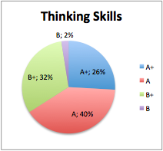
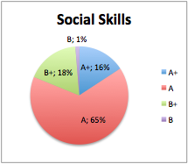
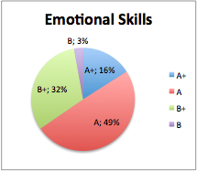
LIFE SKILLS ASSESSMENT (all schools)

Slide 22
NEED OF THE HOUR IS
TO HAVE A
COMPREHENSIVE, COHERENT AND CONTINUOUS ASSESSMENT SYSTEM...

Slide 23
THANK YOU!

